Slide 1


Embedded System and Internet of Things (ESIOT)
Microcontrollers and Programming (Unit-2):
B.E.-CSE 3rd Sem.
Department of Interdisciplinary Courses in Engineering (DICE)

Slide 2
Microcontrollers
A microcontroller is a small and low-cost microcomputer, which is designed to perform the specific tasks of embedded systems like displaying microwave’s information, receiving remote signals, etc.
The general microcontroller consists of the processor, the memory (RAM, ROM, EPROM), Serial ports, peripherals (timers, counters), etc.

Slide 3
Difference between Microprocessor and Microcontroller
Microcontroller | Microprocessor
Microcontrollers are used to execute a single task within an application. | Microprocessors are used for big applications.
Its designing and hardware cost is low. | Its designing and hardware cost is high.
Easy to replace. | Not so easy to replace.
It is built with CMOS technology, which requires less power to operate. | Its power consumption is high because it has to control the entire system.
It consists of CPU, RAM, ROM, I/O ports. | It doesn’t consist of RAM, ROM, I/O ports. It uses its pins to interface to peripheral devices.

Slide 4
Types of Microcontrollers
Bit: Based on bit configuration, the microcontroller is further divided into three categories.
8-bit microcontroller − This type of microcontroller is used to execute arithmetic and logical operations like addition, subtraction, multiplication division, etc. For example, Intel 8031 and 8051 are 8 bits microcontroller.
16-bit microcontroller − This type of microcontroller is used to perform arithmetic and logical operations where higher accuracy and performance is required. For example, Intel 8096 is a 16-bit microcontroller.
32-bit microcontroller − This type of microcontroller is generally used in automatically controlled appliances like automatic operational machines, medical appliances, etc.

Slide 5
Types of Microcontrollers
Memory: Based on the memory configuration, the microcontroller is further divided into two categories.
External memory microcontroller − This type of microcontroller is designed in such a way that they do not have a program memory on the chip. Hence, it is named as external memory microcontroller. For example: Intel 8031 microcontroller.
Embedded memory microcontroller − This type of microcontroller is designed in such a way that the microcontroller has all programs and data memory, counters and timers, interrupts, I/O ports are embedded on the chip. For example: Intel 8051 microcontroller.

Slide 6
Types of Microcontrollers
Instruction Set: Based on the instruction set configuration, the microcontroller is further divided into two categories.
CISC − CISC stands for complex instruction set computer. It allows the user to insert a single instruction as an alternative to many simple instructions.
RISC − RISC stands for Reduced Instruction Set Computers. It reduces the operational time by shortening the clock cycle per instruction.

Slide 7
Applications of Microcontrollers
Microcontrollers are widely used in various different devices such as −
Light sensing and controlling devices like LED.
Temperature sensing and controlling devices like microwave oven, chimneys.
Fire detection and safety devices like Fire alarm.
Measuring devices like Volt Meter.

Slide 8
Microcontrollers - 8051 Architecture
8051 microcontroller is designed by Intel in 1981. It is an 8-bit microcontroller.
It is built with 40 pins DIP (dual inline package), 4kb of ROM storage and 128 bytes of RAM storage, 2 16-bit timers.
It consists of are four parallel 8-bit ports, which are programmable as well as addressable as per the requirement.
An on-chip crystal oscillator is integrated in the microcontroller having crystal frequency of 12 MHz.

Slide 9
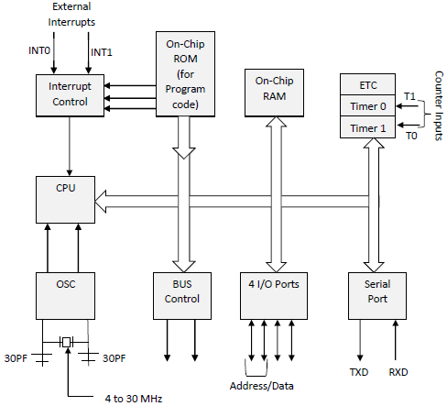
Microcontrollers - 8051 Architecture
The system bus connects all the support devices to the CPU.
The system bus consists of an 8-bit data bus, a 16-bit address bus and bus control signals.
All other devices like program memory, ports, data memory, serial interface, interrupt control, timers, and the CPU are all interfaced together through the system bus.

Slide 10
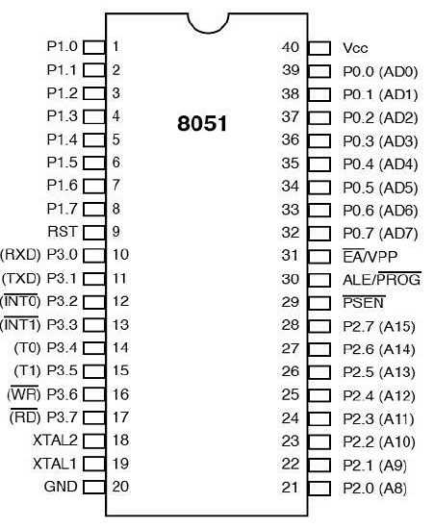
Microcontrollers - 8051 Pin Description
Pins 1 to 8 − These pins are known as Port 1. This port doesn’t serve any other functions. It is internally pulled up, bi-directional I/O port.
Pin 9 − It is a RESET pin, which is used to reset the microcontroller to its initial values.
Pins 10 to 17 − These pins are known as Port 3. This port serves some functions like interrupts, timer input, control signals, serial communication signals RxD and TxD, etc.

Slide 11
Microcontrollers - 8051 Pin Description
Pins 18 & 19 − These pins are used for interfacing an external crystal to get the system clock.
Pin 20 − This pin provides the power supply to the circuit.
Pins 21 to 28 − These pins are known as Port 2. It serves as I/O port. Higher order address bus signals are also multiplexed using this port.
Pin 29 − This is PSEN pin which stands for Program Store Enable. It is used to read a signal from the external program memory.

Slide 12
Microcontrollers - 8051 Pin Description
Pin 30 − This is EA pin which stands for External Access input. It is used to enable/disable the external memory interfacing.
Pin 31 − This is ALE pin which stands for Address Latch Enable. It is used to demultiplex the address-data signal of port.
Pins 32 to 39 − These pins are known as Port 0. It serves as I/O port. Lower order address and data bus signals are multiplexed using this port.
Pin 40 − This pin is used to provide power supply to the circuit.

Slide 13
Microcontrollers 8051 Input Output Ports
8051 microcontrollers have 4 I/O ports each of 8-bit, which can be configured as input or output. Hence, total 32 input/output pins allow the microcontroller to be connected with the peripheral devices.
Pin configuration, i.e. the pin can be configured as 1 for input and 0 for output as per the logic state.
Input/Output (I/O) pin − All the circuits within the microcontroller must be connected to one of its pins except P0 port because it does not have pull-up resistors built-in.
Input pin − Logic 1 is applied to a bit of the P register. The output FE transistor is turned off and the other pin remains connected to the power supply voltage over a pull-up resistor of high resistance.
Port 0 − The P0 (zero) port is characterized by two functions −
When the external memory is used then the lower address byte (addresses A0A7) is applied on it, else all bits of this port are configured as input/output.
When P0 port is configured as an output then other ports consisting of pins with built-in pull-up resistor connected by its end to 5V power supply, the pins of this port have this resistor left out.

Slide 14
Microcontrollers 8051 Input Output Ports
Input Configuration:
If any pin of this port is configured as an input, then it acts as if it “floats”, i.e. the input has unlimited input resistance and in-determined potential.
Output Configuration:
When the pin is configured as an output, then it acts as an “open drain”. By applying logic 0 to a port bit, the appropriate pin will be connected to ground (0V), and applying logic 1, the external output will keep on “floating”.
In order to apply logic 1 (5V) on this output pin, it is necessary to build an external pull up resistor.
Port 1
P1 is a true I/O port as it doesn’t have any alternative functions as in P0, but this port can be configured as general I/O only. It has a built-in pull-up resistor and is completely compatible with TTL circuits.
Port 2
P2 is similar to P0 when the external memory is used. Pins of this port occupy addresses intended for the external memory chip. This port can be used for higher address byte with addresses A8-A15. When no memory is added then this port can be used as a general input/output port similar to Port 1.

Slide 15
Microcontrollers 8051 Input Output Ports
Port 3
In this port, functions are similar to other ports except that the logic 1 must be applied to appropriate bit of the P3 register.
Pins Current Limitations
When pins are configured as an output (i.e. logic 0), then the single port pins can receive a current of 10mA.
When these pins are configured as inputs (i.e. logic 1), then built-in pull-up resistors provide very weak current, but can activate up to 4 TTL inputs of LS series.
If all 8 bits of a port are active, then the total current must be limited to 15mA (port P0: 26mA).
If all ports (32 bits) are active, then the total maximum current must be limited to 71mA.

Slide 16
Pins Current Limitations
When pins are configured as an output (i.e. logic 0), then the single port pins can receive a current of 10mA.
When these pins are configured as inputs (i.e. logic 1), then built-in pull-up resistors provide very weak current, but can activate up to 4 TTL inputs of LS series.
If all 8 bits of a port are active, then the total current must be limited to 15mA (port P0: 26mA).
If all ports (32 bits) are active, then the total maximum current must be limited to 71mA.

Slide 17
Microcontrollers - 8051 Interrupts
Interrupts are the events that temporarily suspend the main program, pass the control to the external sources and execute their task. It then passes the control to the main program where it had left off.
8051 has 5 interrupt signals, i.e. INT0, TFO, INT1, TF1, RI/TI. Each interrupt can be enabled or disabled by setting bits of the IE register and the whole interrupt system can be disabled by clearing the EA bit of the same register.

Slide 18
Microcontrollers - 8051 Interrupts
IE (Interrupt Enable) Register:
This register is responsible for enabling and disabling the interrupt. EA register is set to one for enabling interrupts and set to 0 for disabling the interrupts. Its bit sequence and their meanings are shown in the following figure.
EA | IE.7 | It disables all interrupts. When EA = 0 no interrupt will be acknowledged and EA = 1 enables the interrupt individually.
- | IE.6 | Reserved for future use.
- | IE.5 | Reserved for future use.
ES | IE.4 | Enables/disables serial port interrupt.
ET1 | IE.3 | Enables/disables timer1 overflow interrupt.
EX1 | IE.2 | Enables/disables external interrupt1.
ET0 | IE.1 | Enables/disables timer0 overflow interrupt.
EX0 | IE.0 | Enables/disables external interrupt0.

Slide 19
Microcontrollers - 8051 Interrupts
IP (Interrupt Priority) Register:
We can change the priority levels of the interrupts by changing the corresponding bit in the Interrupt Priority (IP) register as shown in the following figure.
A low priority interrupt can only be interrupted by the high priority interrupt, but not interrupted by another low priority interrupt.
If two interrupts of different priority levels are received simultaneously, the request of higher priority level is served.
If the requests of the same priority levels are received simultaneously, then the internal polling sequence determines which request is to be serviced.

Slide 20
Microcontrollers - 8051 Interrupts
- | IP.6 | Reserved for future use.
- | IP.5 | Reserved for future use.
PS | IP.4 | It defines the serial port interrupt priority level.
PT1 | IP.3 | It defines the timer interrupt of 1 priority.
PX1 | IP.2 | It defines the external interrupt priority level.
PT0 | IP.1 | It defines the timer0 interrupt priority level.
PX0 | IP.0 | It defines the external interrupt of 0 priority level.
TCON Register:
TCON register specifies the type of external interrupt to the microcontroller.

Slide 21
8255A - Programmable Peripheral Interface
The 8255A is a general purpose programmable I/O device designed to transfer the data from I/O to interrupt I/O under certain conditions as required. It can be used with almost any microprocessor.
It consists of three 8-bit bidirectional I/O ports (24I/O lines) which can be configured as per the requirement.
Ports of 8255A:
8255A has three ports, i.e., PORT A, PORT B, and PORT C.
Port A contains one 8-bit output latch/buffer and one 8-bit input buffer.
Port B is similar to PORT A.
Port C can be split into two parts, i.e. PORT C lower (PC0-PC3) and PORT C upper (PC7-PC4) by the control word.
These three ports are further divided into two groups, i.e. Group A includes PORT A and upper PORT C. Group B includes PORT B and lower PORT C. These two groups can be programmed in three different modes, i.e. the first mode is named as mode 0, the second mode is named as Mode 1 and the third mode is named as Mode 2.

Slide 22
8255A - Programmable Peripheral Interface
Operating Modes:
8255A has three different operating modes −
Mode 0 − In this mode, Port A and B is used as two 8-bit ports and Port C as two 4-bit ports. Each port can be programmed in either input mode or output mode where outputs are latched and inputs are not latched. Ports do not have interrupt capability.
Mode 1 − In this mode, Port A and B is used as 8-bit I/O ports. They can be configured as either input or output ports. Each port uses three lines from port C as handshake signals. Inputs and outputs are latched.
Mode 2 − In this mode, Port A can be configured as the bidirectional port and Port B either in Mode 0 or Mode 1. Port A uses five signals from Port C as handshake signals for data transfer. The remaining three signals from Port C can be used either as simple I/O or as handshake for port B.

Slide 23
8255A - Programmable Peripheral Interface
Features of 8255A:
The prominent features of 8255A are as follows −
It consists of 3 8-bit IO ports i.e. PA, PB, and PC.
Address/data bus must be externally demux'd.
It is TTL compatible.
It has improved DC driving capability.

Slide 24
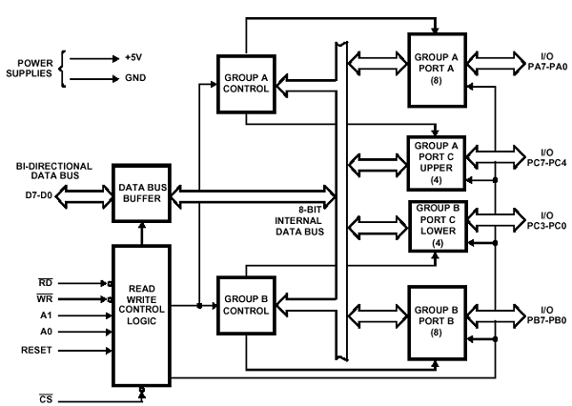
8255A - Programmable Peripheral Interface
8255 Architecture:
The following figure shows the architecture of 8255A −

Slide 25
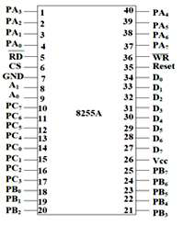
Intel 8255A - Pin Description
Data Bus Buffer:
It is a tri-state 8-bit buffer, which is used to interface the microprocessor to the system data bus. Data is transmitted or received by the buffer as per the instructions by the CPU. Control words and status information is also transferred using this bus.
Read/Write Control Logic:
This block is responsible for controlling the internal/external transfer of data/control/status word. It accepts the input from the CPU address and control buses, and in turn issues command to both the control groups.

Slide 26
Intel 8255A - Pin Description
CS:
It stands for Chip Select. A LOW on this input selects the chip and enables the communication between the 8255A and the CPU. It is connected to the decoded address, and A₀ & A₁ are connected to the microprocessor address lines.
Their result depends on the following conditions −
CS | A₁ | A₀ | Result
0 | 0 | 0 | PORT A
0 | 0 | 1 | PORT B
0 | 1 | 0 | PORT C
0 | 1 | 1 | Control Register
1 | X | X | No Selection

Slide 27
Intel 8255A - Pin Description
A₀ and A₁:These input signals work with RD, WR, and one of the control signal. Following is the table showing their various signals with their result.
A₁ | A₀ | RD | WR | CS | Result
0 | 0 | 0 | 1 | 0 | Input Operation PORT A → Data Bus
0 | 1 | 0 | 1 | 0 | PORT B → Data Bus
1 | 0 | 0 | 1 | 0 | PORT C → Data Bus
0 | 0 | 1 | 0 | 0 | Output Operation Data Bus → PORT A
0 | 1 | 1 | 0 | 0 | Data Bus → PORT A
1 | 0 | 1 | 0 | 0 | Data Bus → PORT B
1 | 1 | 1 | 0 | 0 | Data Bus → PORT D

Slide 28
Intel 8253 - Programmable Interval Timer
The Intel 8253 and 8254 are Programmable Interval Timers (PTIs) designed for microprocessors to perform timing and counting functions using three 16-bit registers.
Each counter has 2 input pins, i.e. Clock & Gate, and 1 pin for “OUT” output. To operate a counter, a 16-bit count is loaded in its register.
On command, it begins to decrement the count until it reaches 0, then it generates a pulse that can be used to interrupt the CPU.
Difference between 8253 and 8254:
8253 | 8254
Its operating frequency is 0 - 2.6 MHz | Its operating frequency is 0 - 10 MHz
It uses N-MOS technology | It uses H-MOS technology
Read-Back command is not available | Read-Back command is available
Reads and writes of the same counter cannot be interleaved. | Reads and writes of the same counter can be interleaved.

Slide 29
Intel 8253 - Programmable Interval Timer
Features of 8253 / 54:
The most prominent features of 8253/54 are as follows −
It has three independent 16-bit down counters.
It can handle inputs from DC to 10 MHz.
These three counters can be programmed for either binary or BCD count.
It is compatible with almost all microprocessors.
8254 has a powerful command called READ BACK command, which allows the user to check the count value, the programmed mode, the current mode, and the current status of the counter.

Slide 30
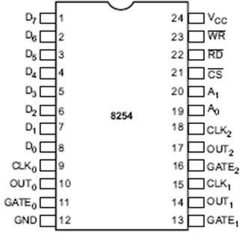
8254 Pin Description
There are three counters, a data bus buffer, Read/Write control logic, and a control register. Each counter has two input signals - CLOCK & GATE, and one output signal - OUT.
Data Bus Buffer:
It is a tri-state, bi-directional, 8-bit buffer, which is used to interface the 8253/54 to the system data bus. It has three basic functions −
Programming the modes of 8253/54.
Loading the count registers.
Reading the count values.

Slide 31
8254 Pin Description
Read/Write Logic:
It includes 5 signals, i.e. RD, WR, CS, and the address lines A₀ & A₁. In the peripheral I/O mode, the RD and WR signals are connected to IOR and IOW, respectively. In the memory mapped I/O mode, these are connected to MEMR and MEMW.
Address lines A₀ & A₁ of the CPU are connected to lines A₀ and A₁ of the 8253/54, and CS is tied to a decoded address. The control word register and counters are selected according to the signals on lines A₀ & A₁.

Slide 32
8254 Pin Description
A₁ | A₀ | Result
0 | 0 | Counter 0
0 | 1 | Counter 1
1 | 0 | Counter 2
1 | 1 | Control Word Register
X | X | No Selection

Slide 33
8254 Pin Description
Control Word Register:
This register is accessed when lines A0 & A1 are at logic 1. It is used to write a command word, which specifies the counter to be used, its mode, and either a read or write operation.

Slide 34
8254 Pin Description
A₁ | A₀ | RD | WR | CS | Result
0 | 0 | 1 | 0 | 0 | Write Counter 0
0 | 1 | 1 | 0 | 0 | Write Counter 1
1 | 0 | 1 | 0 | 0 | Write Counter 2
1 | 1 | 1 | 0 | 0 | Write Control Word
0 | 0 | 0 | 1 | 0 | Read Counter 0
0 | 1 | 0 | 1 | 0 | Read Counter 1
1 | 0 | 0 | 1 | 0 | Read Counter 2
1 | 1 | 0 | 1 | 0 | No operation
X | X | 1 | 1 | 0 | No operation
X | X | X | X | 1 | No operation

Slide 35
8254 Pin Description
Counters:
Each counter consists of a single, 16 bit-down counter, which can be operated in either binary or BCD.
Its input and output is configured by the selection of modes stored in the control word register.
The programmer can read the contents of any of the three counters without disturbing the actual count in process.

Slide 36
Intel 8253/54 - Operational Modes
8253/54 can be operated in different modes.
Mode 0 ─ Interrupt on Terminal Count:
It is used to generate an interrupt to the microprocessor after a certain interval.
Initially the output is low after the mode is set. The output remains LOW after the count value is loaded into the counter.
The process of decrementing the counter continues till the terminal count is reached, i.e., the count become zero and the output goes HIGH and will remain high until it reloads a new count.
The GATE signal is high for normal counting. When GATE goes low, counting is terminated and the current count is latched till the GATE goes high again.
Mode 1 – Programmable One Shot:
It can be used as a mono stable multi-vibrator.
The gate input is used as a trigger input in this mode.
The output remains high until the count is loaded and a trigger is applied.

Slide 37
Intel 8253/54 - Operational Modes
Mode 2 – Rate Generator:
The output is normally high after initialization.
Whenever the count becomes zero, another low pulse is generated at the output and the counter will be reloaded.
Mode 3 – Square Wave Generator:
This mode is similar to Mode 2 except the output remains low for half of the timer period and high for the other half of the period.
Mode 4 − Software Triggered Mode:
In this mode, the output will remain high until the timer has counted to zero, at which point the output will pulse low and then go high again.
The count is latched when the GATE signal goes LOW.
On the terminal count, the output goes low for one clock cycle then goes HIGH. This low pulse can be used as a strobe.

Slide 38
Intel 8253/54 - Operational Modes
Mode 5 – Hardware Triggered Mode:
This mode generates a strobe in response to an externally generated signal.
This mode is similar to mode 4 except that the counting is initiated by a signal at the gate input, which means it is hardware triggered instead of software triggered.
After it is initialized, the output goes high.
When the terminal count is reached, the output goes low for one clock cycle.

Slide 39
PSW (Program Status Word) Register in 8051 Microcontroller
Flags are single bit register and used to store the result of certain function after executing instruction. Flags are grouped inside PSW and PCON registers.
PSW register in 8051 microcontroller contains math flags and PCON contains general user flags.
Math flags are grouped in PSW of microcontroller 8051 and they are Carry(C), Auxiliary Carry (AC), Over flow (OV), and Parity (P). The general user flags are GF0 and GF1 which are grouped in PCON register.

Slide 40
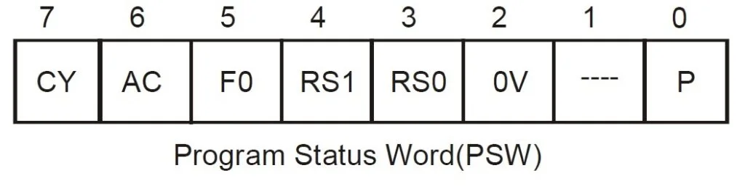
PSW (Program Status Word) Register in 8051 Microcontroller
The PSW is accessible fully as an 8-bit register.
The bit pattern of this flag register is

Slide 41
PSW (Program Status Word) Register in 8051 Microcontroller
Parity bit (P)
This parity flag bit is used to show the number of 1s in the accumulator only. If the accumulator register contains an odd number of 1s, then this flag set to 1.
If accumulator contains even number of 1s, then this flag cleared to 0.

Slide 42
PSW (Program Status Word) Register in 8051 Microcontroller
Overflow flag (OV)
This flag is set during ALU operations, to indicate overflow in the result. It is set to 1 if there is a carry out of either the D7 bit or the D6 bit of the accumulator.
Overflow flag is set when arithmetic operations such as add and subtract result in sign conflict.
The conditions under which the OV flag is set :
Positive + Positive = Negative
Negative + Negative = Positive
Positive – Negative = Negative
Negative – Positive = Positive

Slide 43
PSW (Program Status Word) Register in 8051 Microcontroller
Register bank select bits (RS1 and RS0):
These two bits are used to select one of four register banks of RAM. By setting and clearing these bits, registers R0-R7 are stored in one of four banks of RAM.
RS1 | RS0 | Bank Selected | Address of Registers
0 | 0 | Bank 0 | 00h-07h
0 | 1 | Bank 1 | 08h-0Fh
1 | 0 | Bank 2 | 10h-17h
1 | 1 | Bank 3 | 18h-1Fh

Slide 44
PSW (Program Status Word) Register in 8051 Microcontroller
General-purpose flag (F0):
This is a user-programmable flag; the user can program and store any bit of his/her choice in this flag, using the bit address.
Auxiliary carry flag (AC):
It is used in association with BCD arithmetic. This flag is set when there is a carry out of the D3 bit of the accumulator.
Carry flag (CY):
This flag is used to indicate the carry generated after arithmetic operations. It can also be used as an accumulator, to store one of the data bits for bit-related Boolean instructions.

Slide 45
Addressing Modes of 8051
In 8051 there are 1-byte, 2-byte instructions and very few 3-byte instructions are present. The opcodes are 8-bit long. As the opcodes are 8-bit data, there are 256 possibilities. Among 256, 255 opcodes are implemented.
In 8051 There are six types of addressing modes.
Immediate Addressing Mode
Register Addressing Mode
Direct Addressing Mode
Register Indirect Addressing Mode
Indexed Addressing Mode
Implied Addressing Mode

Slide 46
Addressing Modes of 8051
Immediate addressing mode:
The data is provided in the instruction itself. The data is provided immediately after the opcode. These are some examples of Immediate Addressing Mode.
MOVA, #0AFH;
MOVR3, #45H;
MOVDPTR, #FE00H;
In these instructions, the # symbol is used for immediate data. In the last instruction, there is DPTR. The DPTR stands for Data Pointer. Using this, it points the external data memory location.
In the first instruction, the immediate data is AFH, but one 0 is added at the beginning. So when the data is starting with A to F, the data should be preceded by 0.

Slide 47
Addressing Modes of 8051
Register addressing mode:
The source or destination data should be present in a register (R0 to R7). These are some examples of Register Addressing Mode.
MOVA, R5;
MOVR2, #45H;
MOVR0, A;
In 8051, there is no instruction like MOVR5, R7. But we can get the same result by using this instruction MOV R5, 07H, or by using MOV 05H, R7. But this two instruction will work when the selected register bank is RB0. To use another register bank and to get the same effect, we have to add the starting address of that register bank with the register number.
For an example, if the RB2 is selected, and we want to access R5, then the address will be (10H + 05H = 15H), so the instruction will look like this MOV 15H, R7. Here 10H is the starting address of Register Bank 2.

Slide 48
Addressing Modes of 8051
Direct Addressing Mode:
The source or destination address is specified by using 8-bit data in the instruction. Only the internal data memory can be used in this mode. Here some of the examples of direct Addressing Mode.
MOV80H, R6;
MOVR2, 45H;
MOVR0, 05H;
The first instruction will send the content of register R6 to port P0 (Address of Port 0 is 80H).
The second one is forgetting content from 45H to R2.
The third one is used to get data from Register R5 (When register bank RB0 is selected) to register R5.

Slide 49
Addressing Modes of 8051
Register indirect addressing Mode:
In this mode, the source or destination address is given in the register. By using register indirect addressing mode, the internal or external addresses can be accessed. The R0 and R1 are used for 8-bit addresses, and DPTR is used for 16-bit addresses, no other registers can be used for addressing purposes. Let us see some examples of this mode.
MOV0E5H, @R0;
MOV@R1, 80H
In the instructions, the @ symbol is used for register indirect addressing. In the first instruction, it is showing that the R0 register is used. If the content of R0 is 40H, then that instruction will take the data which is located at location 40H of the internal RAM.
In the second one, if the content of R1 is 30H, then it indicates that the content of port P0 will be stored at location 30H in the internal RAM.

Slide 50
Addressing Modes of 8051
MOVXA, @R1;
MOV@DPTR, A;
In these two instructions, the X in MOVX indicates the external data memory.
The external data memory can only be accessed in register indirect mode.
In the first instruction if the R1 is holding 25H, then A will get the content of external RAM location40H.
In the second one, the content of A is overwritten in the location pointed by DPTR.

Slide 51
Addressing Modes of 8051
Indexed addressing mode:
In the indexed addressing mode, the source memory can only be accessed from program memory only. The destination operand is always the register A. These are some examples of Indexed addressing mode.
MOVCA, @A+PC;
MOVCA, @A+DPTR;
The C in MOVC instruction refers to code byte. For the first instruction, let us consider A holds 30H. And the PC value is1125H. The contents of program memory location 1155H (30H + 1125H) are moved to register A.
Second example works similarly but uses the Data Pointer (DPTR) instead of the PC.

Slide 52
Addressing Modes of 8051
Example Breakdown: Consider the instruction:
MOVC A, @A + PC
Given Values:
Register A = 30H
PC = 1125H
Calculation:
Effective Address = A + PC = 30H + 1125H
Memory Access:
The instruction moves the contents of program memory location 1155H to register A.

Slide 53
Addressing Modes of 8051
Implied Addressing Mode:
In the implied addressing mode, there will be a single operand. These types of instruction can work on specific registers only. These types of instructions are also known as register specific instruction. Here are some examples of Implied Addressing Mode.
RLA;
SWAPA;
These are 1- byte instruction. The first one is used to rotate the A register content to the Left. The second one is used to swap the nibbles in A.

Slide 54
Instruction Set of 8051
The instructions of 8051 Microcontroller can be classified into five different groups. These groups are like below
Data Transfer Group
Arithmetic Group
Logical Group
Program Branch Group
Bit Processing Group
This Bit-Processing group is also known as Boolean Variable Manipulation.
Like 8085, some instruction has two operands. The first operand is the Destination, and the second operator is Source.

Slide 55
Instruction Set of 8051
Examples:
Rn = Any register from R0to R7
Ri = Either R0 or R1
d8 = Any 8-bit immediate data (00H to FFH)
d16 = 16-bit immediate data
a8 = 8-bit address
bit = 8-bit address of bit which is bit addressable
rel = 8-bit signed displacement. The range is -128 to 127. It is relative to the first byte of the instruction.

Slide 56
Instruction Set of 8051
Arithmetic group in 8051:
In 8051 Microcontroller there are 24 different instructions under the Arithmetic Group. In total there are 64 opcodes.
The Carry Flag (CY), Auxiliary Carry (AC)and Overflow flag (OV) are affected based on the result of ADD, ADDC, SUBB etc. instructions.
The multiple and divide instructions clear the Carry flag, and also does not affect the AC flag. After execution of multiplication, the OV flag will be 1 when the result is greater than FFH.
Otherwise, it is 0. Similarly, after division OV flag is 1 when the content of B is 00H before division, otherwise it is 0. The DA A (Decimal Adjust Accumulator) affects the Carry Flag only.

Slide 57
Instruction Set of 8051
We will see the Mnemonics, Lengths, Execution Time in terms of the machine cycle, Number of Opcodes etc.
Mnemonics | Byte Count | Execution time | Opcode Count
ADD A, Rn | 1 | 1 | 8
ADD A, a8 | 2 | 1 | 1
ADD A, @Ri | 1 | 1 | 2
ADD A, #d8 | 2 | 1 | 1
ADDC A, Rn | 1 | 1 | 8
ADDC A, a8 | 2 | 1 | 1
ADDC A, @Ri | 1 | 1 | 2
ADDC A, #d8 | 2 | 1 | 1

Slide 58
Instruction Set of 8051
We will see the Mnemonics, Lengths, Execution Time in terms of the machine cycle, Number of Opcodes etc.
Mnemonics | Byte Count | Execution time | Opcode Count
SUBB A, Rn | 1 | 1 | 8
SUBB A, a8 | 2 | 1 | 1
SUBB A, @Ri | 1 | 1 | 2
SUBB A, #d8 | 2 | 1 | 1
INC A | 1 | 1 | 1
INC Rn | 1 | 1 | 8
INC a8 | 2 | 1 | 1
INC @Ri | 1 | 1 | 2

Slide 59
Instruction Set of 8051
We will see the Mnemonics, Lengths, Execution Time in terms of the machine cycle, Number of Opcodes etc.
Mnemonics | Byte Count | Execution time | Opcode Count
DEC A | 1 | 1 | 1
DEC Rn | 1 | 1 | 8
DEC a8 | 2 | 1 | 1
DEC @Ri | 1 | 1 | 2
INC DPTR | 1 | 2 | 1
MUL AB | 1 | 4 | 1
DIV AB | 1 | 4 | 1
DA A | 1 | 1 | 1

Slide 60
Instruction Set of 8051
Examples:
Sr. No | Instruction & Description
1 | ADD A, 32H This is an instruction of type ADD A, #d8. The immediate data 32H is added to register A. The result is also stored in A.
2 | ADDC A, @R1 This is an instruction of type ADDC A, @Ri. It means the content on internal RAM location which is pointed by register R1 is added to A.
3 | SUBB A, R5 This is SUBB A, Rn type instruction. The SUBBstands for Subtract with borrow. So the content of R5 will be subtracted from A.
4 | INC 40H This is a type of INC a8. Here the content in local RAM whose address is 40H, it is increased by 1.

Slide 61
Instruction Set of 8051
Examples:
Sr. No | Instruction & Description
5 | INC DPTR It can increase the content of DPTR by 1. This instruction takes two machine cycle to execute.
6 | MUL AB This instruction is used to multiply the content of register A and B. The 16-bit address will be stored at B and A registers. The B will hold the MS byte, and A will hold the LSByte.
7 | DIV AB This instruction is used to divide the content of A register by B register. The 8-bit quotient is stored into the register A, and the 8-bit remainder is stored into the register B.

Slide 62
Serial Port in 8051
8051 Microcontroller has capability to perform parallel as well as serial communication.

Slide 63
Serial Port in 8051
Parallel communication in 8051:
8051 can do 8-bit parallel communication as it has 8-bit ALU. For parallel communication, any of the ports ( P0 / P1 / P2 / P3 ) is used as a transmission channel between transmitter and receiver.

Slide 64
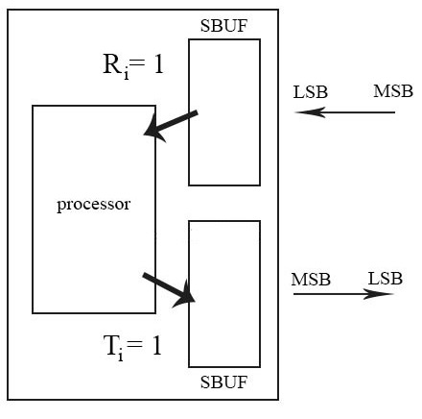
Serial Port in 8051
Serial communication in 8051:
For serial communication there are two separate pins known as serial port of 8051.

Slide 65
Serial Port in 8051
TxD:
This pin basically acts as a transmitter ( sending data ), but in some other modes it doesn’t do the job of transmitter.
As it is serial communication, it sends bit by bit, the processor gives 8-bit at 1 time and those 8-bits are stored in a register named SBUF.
Processor gives 1 byte of data that is to be transmitted to SBUF and from there bit by bit is transferred , firstly LSB and then at last MSB of the byte stored in SBUF.

Slide 66
Serial Port in 8051
Once the total byte is transmitted, an interrupt is sent to the processor by making some flag 1, so that the processor can send more data for transmission as soon as the interrupt is received.

Slide 67
Serial Port in 8051
After every bit is transmitted, it requires delay for next bit transmission. So SBUF needs triggering which is provided by
Timer T1 ( here T1 only needs to trigger). Here we can vary the delay, so data transmission delay can be varied ( frequency can be varied ). It has a variable baud rate.
There is an internal clock in 8051 ( f_{osc} / 12 = 1Mhz ) , where delay cannot be varied, this has fixed trigger delay. So frequency cannot be varied. It has a fixed baud rate.

Slide 68
Serial Port in 8051
Whenever SBUF transferred 8bit of data , T_{i} flag becomes 1. Whenever processors go to ISR( in other interrupts the flag is auto cleared) , in this the T_{i} flag is not auto cleared.

Slide 69
Serial Port in 8051
RxD:
This pin is basically for data reception . It received data bit by bit ( as the transmitter sends LSB first, it received LSB first ).
There is also a register SBUF which stores 8 received bits. Once the 8 bits are received, instead of sending an interrupt it firstly checks for errors ( errors caused due to transmission).
Once there is no error in the received information R_{i} flag is set and an interrupt is sent to the processor. Processor goes to ISR ( here also R_{i} is not cleared automatically ).

Slide 70
Serial Port in 8051
How are SBUF in TxD and RxD different from each other ?
In SBUF of TxD, data is sent from processor to SBUF
In SBUF of RxD, data is sent from SBUF to the processor.

Slide 71
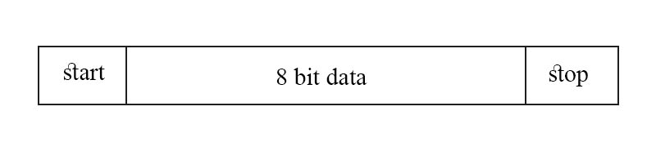
Modes in serial communication:
Mode 1 ( 8-bit UART communication ):
UART stands for universal asynchronous receiver-transmitter. It means receiver and transmitter are asynchronous which mean they don’t have a common clock. Normally 8 bits are transmitted through the channel, but in this mode 10 bits are transmitted.
Here start and stop bits are system generated.

Slide 72
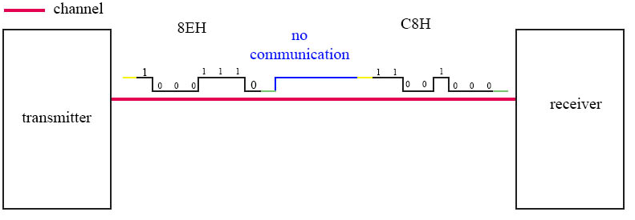
Modes in serial communication:
Significance of start and stop bit:
For eg: There is a transmitter and receiver. First C8H ( 1100 1000 ) data is transmitted and then for 10min there is no transmission and after that again 8EH ( 1000 1110 )is transmitted.
If there is no transmission, last bit transmitted would be remained in the channel
Receiver assumes blue data ( when there was no communication ) also as data.

Slide 73
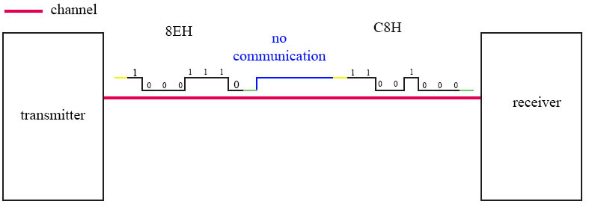
Modes in serial communication:
Here green is the start bit which is zero. And then the yellow colored is stop bit which is 1.
Whenever the first 0 bit comes, the receiver discards the start bit and accepts the next 8 bits and stores in SBUF.
Then the 9th bit is 1 , this bit is stored in RB8.
Then after this whenever the next zero bit comes ( that zero bit is discarded and accepts the next 8 bits and so on ).

Slide 74
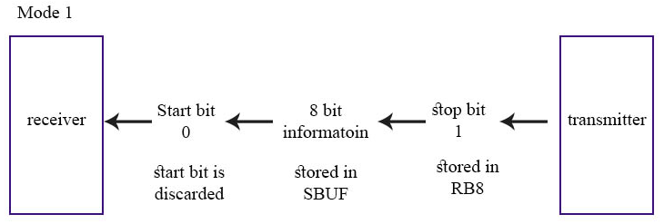
Modes in serial communication:
Stop bit is also used for error checking. Whenever SM2=1, It checks for error, If the RB8 = 1 ( which means stop = 1 received, so the data is received correctly ) and if RB8=0 ( transmitter generated stop as 1, but received as 0 ) so there is an error. If there is an error in received data, no interrupt is sent to the processor.
This mode is variable baud rate, which means it is triggered by timer 1.

Slide 75

Modes in serial communication:
Mode 2 ( 9-bit UART communication ):
The 9th bit is a programmable bit and it is given through TB8. Here 9th bit is 1 and it is used for error checking and stop bit for triggering the data high ( so start bit gets 0 and so on ).
Why the 9th bit , when the already stop bit exists?
Standard value of 9th bit is 1 and can be made 0.
Whenever SM2 = 1( receiver accepts only errorless data ) and if 9th bit is 1, then only errorless data is accepted or else discarded. Discarding data is a purpose.

Slide 76
Modes in serial communication:
Mode 2 ( 9-bit UART communication ):
Example: For broadcast all the receivers should receive data, in this case 9th bit = 1, so that if the receiver has SM₂ = 1 or 0, it can receive data.
For selected transmission ( a paid channel in setup box ), in this case
If the person paid for the premium channel ( the paid channel’s 9th bit = 0 )
His setup box’s SM₂ = 0
So that he can receive data
If the person didn’t pay for that paid channel
His setup box’s SM₂ = 1 ( checks for error )
So he cannot receive data because it has error ( here error is not an error, according to receiver the premium channel has error and dont show it )
This mode also has varied frequency, it has varied baud rate.

Slide 77
Modes in serial communication:
Mode 3 ( 9-bit UART communication ):
This mode is completely similar to mode 2, in mode 2 for triggering timer is used Whereas in this mode internal clock is used for triggering. It has a fixed baud rate.
Mode 0 :
Totally there were four modes in serial port of 8051, but for better understanding mode 0 is explained after three modes. In this mode data is transferred and received only through the RxD channel. TxD is used for clocks. This is synchronous mode of communication.
Such a system is also known as half duplex mode. It has fixed baud rate.

Slide 78

Modes in serial communication:
SCON register:
SM₀ and SM₁: These are used to select the mode.
SM₀ | SM₁ | Mode
0 | 0 | 0
0 | 1 | 1
1 | 0 | 2
1 | 1 | 3

Slide 79
Modes in serial communication:
SCON register:
SM₂: If SM₂ = 1, error is checked Or else no error checking is done.
REN: Receiver enable, If REN=1, receiver will receive the data or else not.
TB₈: This is the 9th bit to be transmitted.
RB₈: This is the 9th bit to be received.
T_{i} : When 8-bits are received in SBUF , then R_{i} = 1, that would send an interrupt to the processor.
R_{i} : When 8-bits are sent from SBUF,and SBUF is empty , then R_{i} = 1, that would send an interrupt to the processor. Before R_{i}=1, it checks for error based on SM₂.

